Slide 1

AI TeleBot – AI-Powered Calling Agent Platform
Automating fundraising outreach with conversational AI technology that scales personalized communication

Slide 2

THE CHALLENGE
Manual Outbound Calling Limits Growth
Hard to Scale
Limited by team size and working hours, manual calling can't reach thousands of prospects efficiently
Inconsistent Messaging
Each caller delivers different information, creating confusion and reducing campaign effectiveness
High Costs
Staffing dedicated call teams requires significant investment in hiring, training, and management
Weak Analytics
Manual tracking provides limited visibility into performance, interest levels, and conversion patterns
Organizations need a solution that delivers personalized communication at scale while providing measurable, data-driven results.

Slide 3

OUR SOLUTION
AI TeleBot: Intelligence Meets Conversation
AI TeleBot is an AI-powered outbound calling platform that transforms fundraising outreach. Our intelligent voice agent conducts natural, multi-turn conversations with recipients, delivering consistent messaging while adapting to each individual's responses.
The platform combines advanced conversational AI with a powerful campaign management dashboard, enabling organizations to reach thousands of prospects with the personalization and effectiveness of one-on-one communication.
01
Calls recipients automatically
02
Conducts real-time conversations
03
Explains campaigns and answers FAQs
04
Detects interest and intent signals

Slide 4

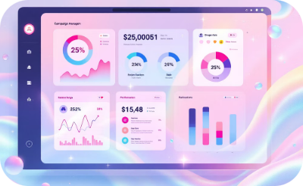


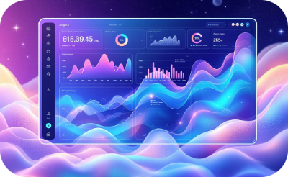

PLATFORM CAPABILITIES
Comprehensive Features for Campaign Success
AI Voice Calling Agent
Campaign Dashboard
Contact Management
Call Recording & Transcription
Natural language conversations that adapt to recipient responses in real-time
Centralized control center for creating, launching, and monitoring all campaigns
Easy contact upload with flexible campaign scheduling and targeting options
Automatic capture and transcription of every conversation for quality assurance
Real-Time Analytics
Interest Detection
Live reporting on call outcomes, engagement rates, and campaign performance
Intelligent tagging of high-intent prospects based on conversation analysis

Slide 5






THE PROCESS
From Contact List to Conversion
AI TeleBot streamlines the entire outbound calling workflow into a simple, automated process that maximizes efficiency and results.
Upload & Configure
Import your contact list and create a customized campaign with tailored messaging and scheduling
Automated Outreach
AI TeleBot initiates outbound calls at optimal times, managing the queue intelligently
Intelligent Conversations
The AI agent engages each recipient with natural dialogue, answering questions and gauging interest
Capture & Analyze
System automatically records, transcribes, and analyzes every call for insights and compliance
Interest Flagging
High-potential prospects are automatically identified and prioritized for follow-up
Seamless Payment (Phase 2)
Interested recipients receive automated SMS with secure payment scanner for instant conversion

Slide 6





ROI & IMPACT
Measurable Business Value
AI TeleBot delivers transformative results across every dimension of fundraising operations, from cost reduction to conversion optimization.
10x
60%
Outreach Scale
Cost Reduction
Reach 10 times more prospects compared to manual calling teams
Lower operational expenses by eliminating staffing and training overhead
100%
3x
Message Consistency
Conversion Potential
Ensure perfect compliance and messaging across every single call
Increase donation conversions with intelligent interest detection and follow-up
"Real-time visibility into campaign performance empowers organizations to make data-driven decisions and optimize outcomes continuously."

Slide 7

WHAT'S NEXT
Product Roadmap & Vision
Phase 1: Core Platform
AI calling agent with natural conversation
Campaign management dashboard
Analytics and reporting suite
Call recording and transcription
1
2
Phase 2: Conversion Optimization
Automated payment SMS delivery
Integrated payment processing
Advanced intent scoring
Multi-channel follow-up automation
Scalable, Data-Driven Fundraising
AI TeleBot enables organizations to conduct thousands of personalized conversations simultaneously, combining the efficiency of automation with the effectiveness of human-like engagement. Transform your fundraising outreach into a measurable, optimized growth engine.
Ready to scale your impact? Let's discuss how AI TeleBot can revolutionize your fundraising operations.

